Slide 1
On handling the uncertainty
Chenyang Wu

Slide 2
Introduction to POMDP

Slide 3
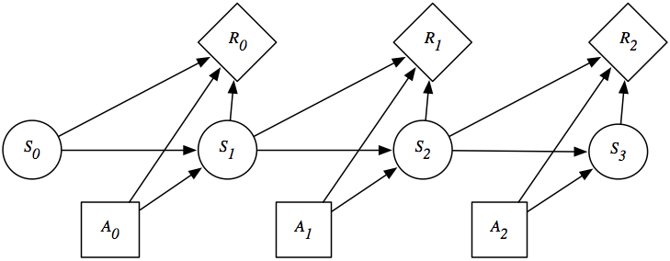
MDP

Slide 4
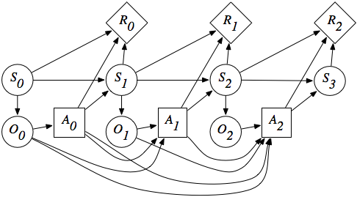
POMDP

Slide 5
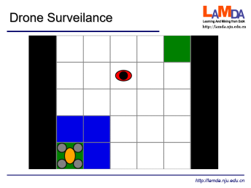
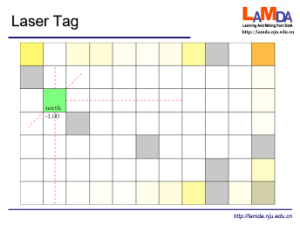
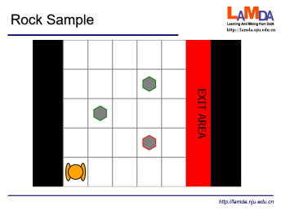
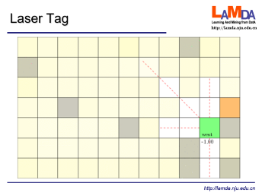
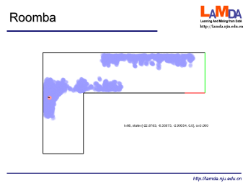
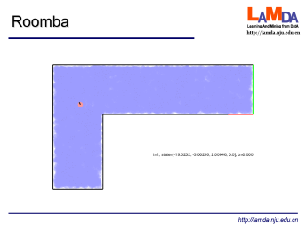
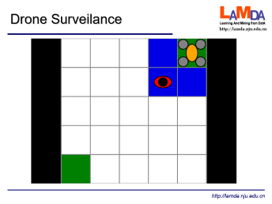

Slide 6
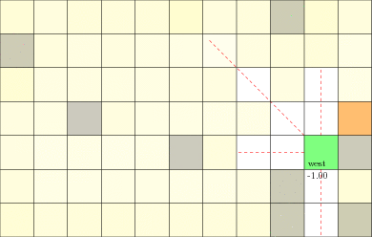
Laser Tag

Slide 7
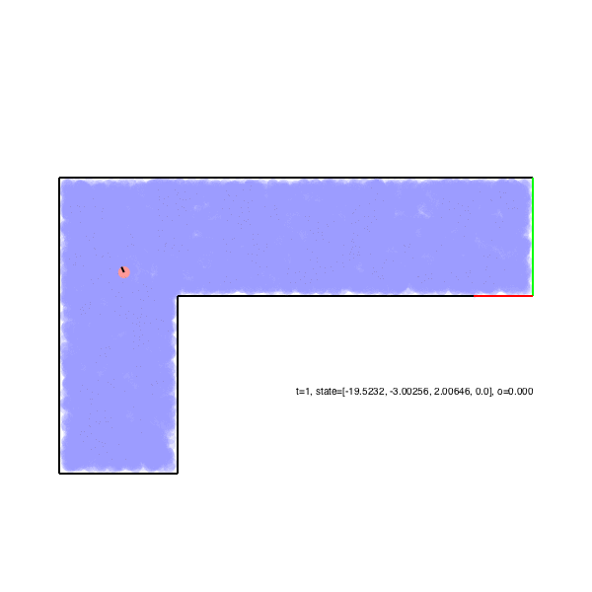
Roomba

Slide 8
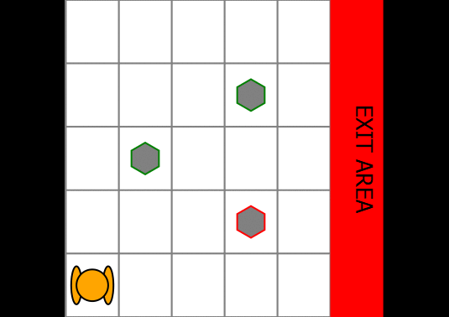
Rock Sample

Slide 9
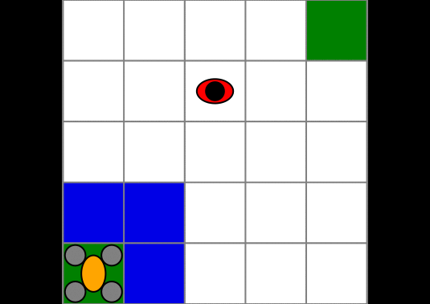
Drone Surveilance

Slide 10
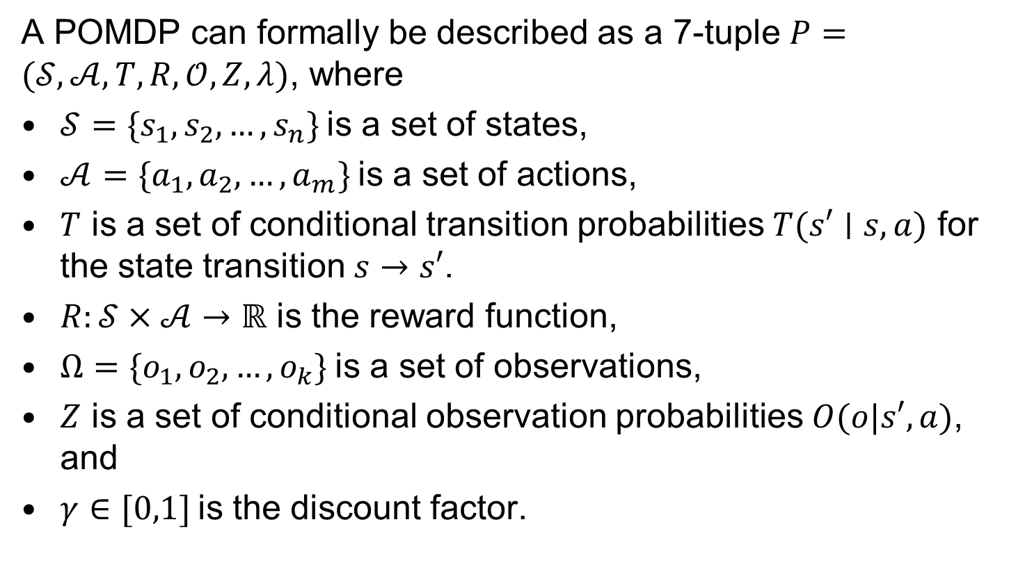
Definition
A POMDP can formally be described as a 7-tuple $P=(𝒮,𝒜,T,R,𝒪,Z,λ)$, where
$𝒮=\{s_{1},s_{2},…,s_{n}\}$is a set of states,
$𝒜=\{a_{1},a_{2},…,a_{m}\}$is a set of actions,
$T$ is a set of conditional transition probabilities $T(s′∣s,a)$ for the state transition $s→s′$.
$R:𝒮×𝒜→ℝ$ is the reward function,
$Ω=\{o_{1},o_{2},…,o_{k}\}$is a set of observations,
$Z$ is a set of conditional observation probabilities $O(o|s′,a)$, and
$γ∈[0,1]$is the discount factor.

Slide 11
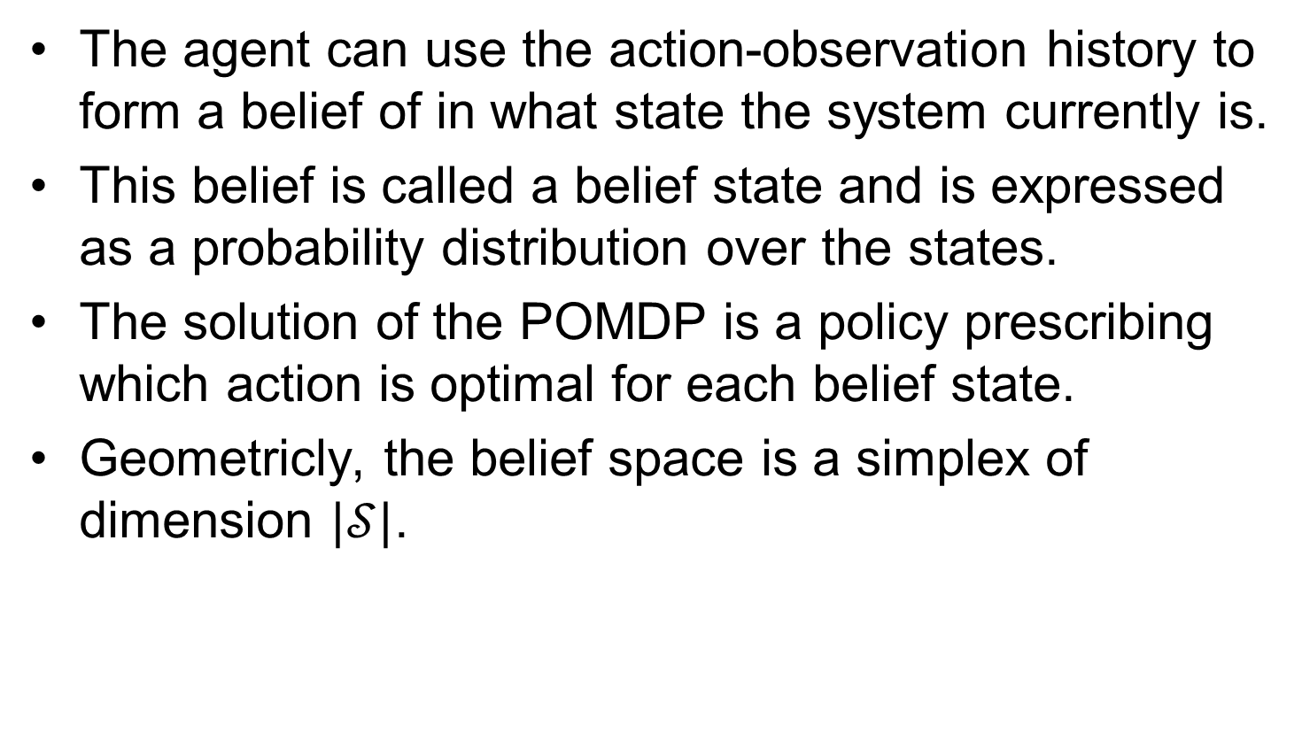
Belief
The agent can use the action-observation history to form a belief of in what state the system currently is.
This belief is called a belief state and is expressed as a probability distribution over the states.
The solution of the POMDP is a policy prescribing which action is optimal for each belief state.
Geometricly, the belief space is a simplex of dimension $|𝒮|$.

Slide 12
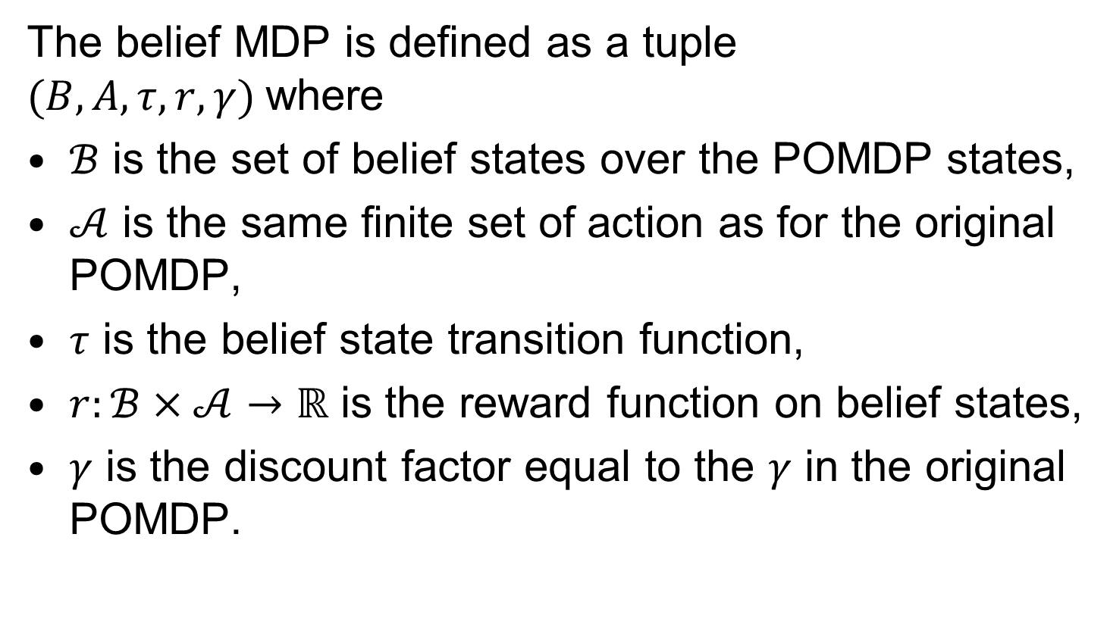
Belief MDP
The belief MDP is defined as a tuple $(B,A,τ,r,γ)$where
$ℬ$ is the set of belief states over the POMDP states,
$𝒜$ is the same finite set of action as for the original POMDP,
$τ$ is the belief state transition function,
$r:ℬ×𝒜→ℝ$ is the reward function on belief states,
$γ$ is the discount factor equal to the $γ$ in the original POMDP.

Slide 13
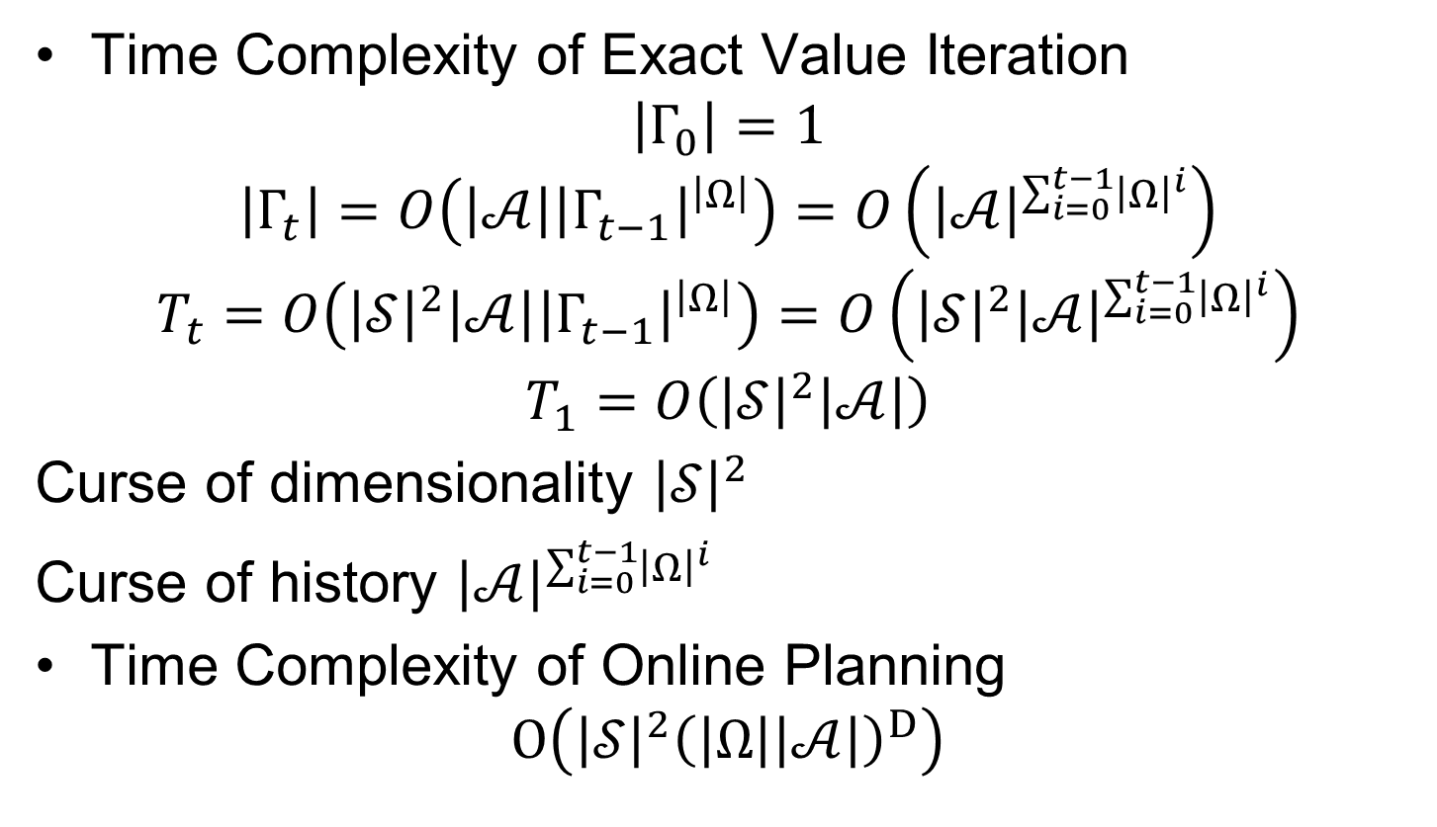
Complexity
Time Complexity of Exact Value Iteration
$$\left|Γ_{0}\right|=1$$
$$\left|Γ_{t}\right|=O\left(\left|𝒜\right|{\left|Γ_{t−1}\right|}^{\left|Ω\right|}\right)=O\left({\left|𝒜\right|}^{\sum_{i=0}^{t−1}{{\left|Ω\right|}^{i}}}\right)$$
$$T_{t}=O\left({\left|𝒮\right|}^{2}\left|𝒜\right|{\left|Γ_{t−1}\right|}^{\left|Ω\right|}\right)=O\left({\left|𝒮\right|}^{2}{\left|𝒜\right|}^{\sum_{i=0}^{t−1}{{\left|Ω\right|}^{i}}}\right)$$
$$T_{1}=O\left({\left|𝒮\right|}^{2}\left|𝒜\right|\right)$$
Curse of dimensionality ${\left|𝒮\right|}^{2}$
Curse of history ${\left|𝒜\right|}^{\sum_{i=0}^{t−1}{{\left|Ω\right|}^{i}}}$
Time Complexity of Online Planning
$$O\left({\left|𝒮\right|}^{2}{\left(\left|Ω\right|\left|𝒜\right|\right)}^{D}\right)$$

Slide 14
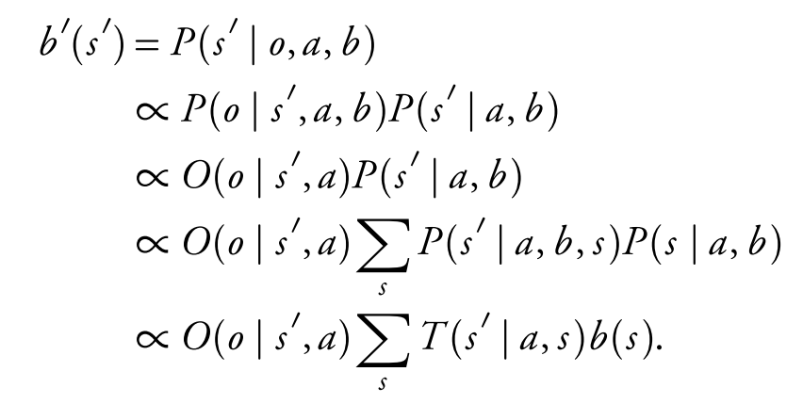
Belief Update

Slide 15
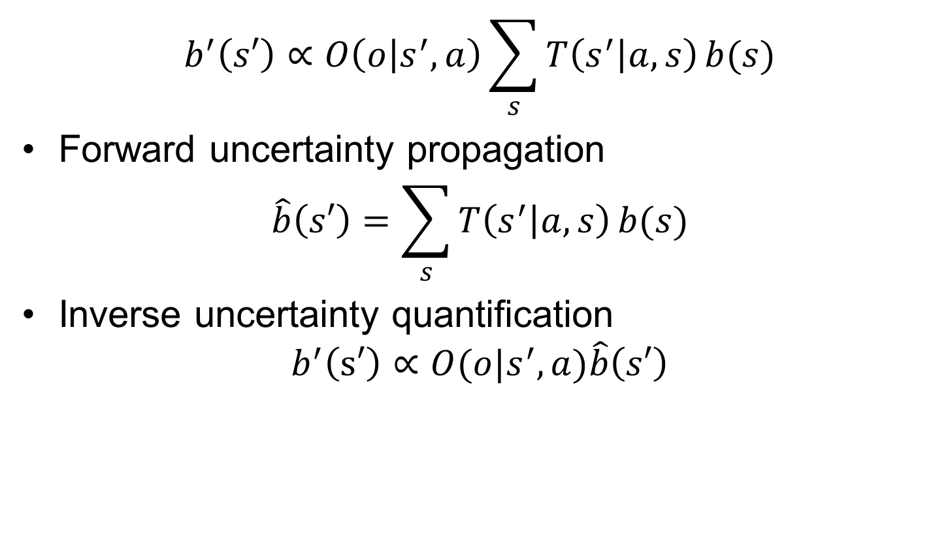
Belief Update
$$b^{′}\left(s′\right)∝O\left(o | s^{′},a\right)\sum_{s}{T\left(s^{′} | a,s\right)}b(s)$$
Forward uncertainty propagation
$$\hat{b}\left(s′\right)=\sum_{s}{T\left(s^{′} | a,s\right)}b(s)$$
Inverse uncertainty quantification
$$b^{′}\left(s′\right)∝O(o|s^{′},a)\hat{b}\left(s′\right)$$

Slide 16
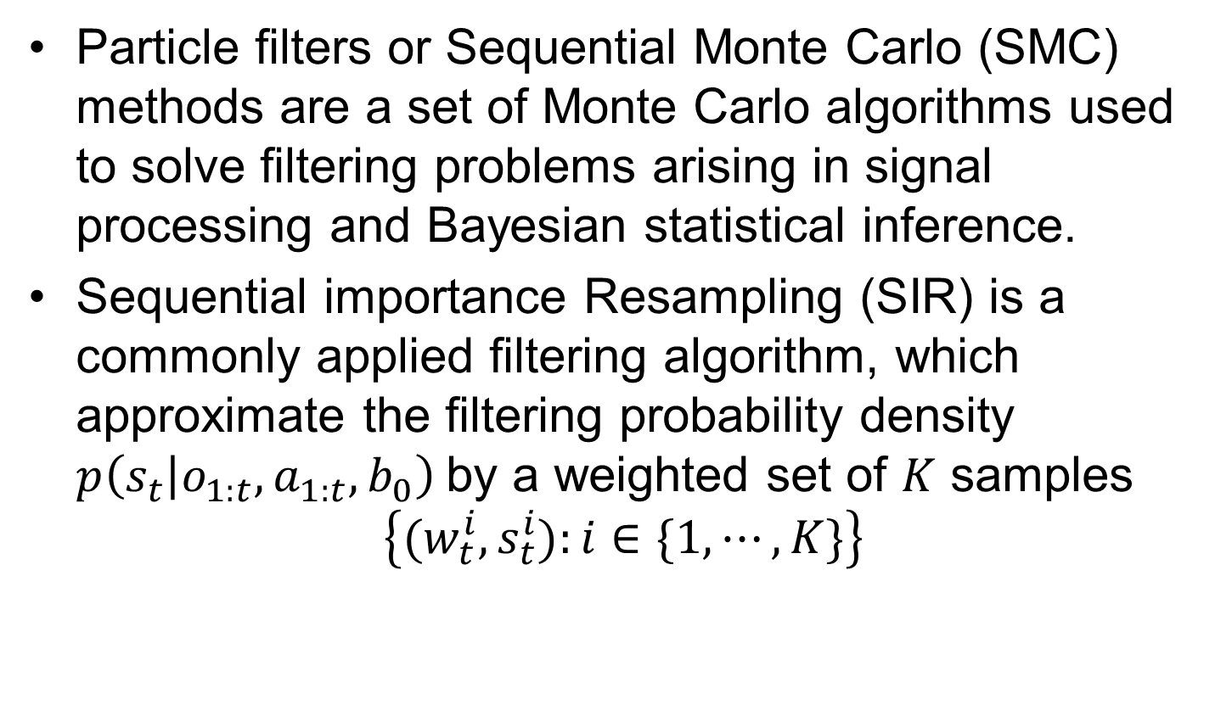
Particle Filters
Particle filters or Sequential Monte Carlo (SMC) methods are a set of Monte Carlo algorithms used to solve filtering problems arising in signal processing and Bayesian statistical inference.
Sequential importance Resampling (SIR) is a commonly applied filtering algorithm, which approximate the filtering probability density $p\left(s_{t} | o_{1:t},a_{1:t},b_{0}\right)$by a weighted set of $K$ samples
$$\left\{(w_{t}^{i},s_{t}^{i}):i∈\{1,⋯,K\}\right\}$$

Slide 17
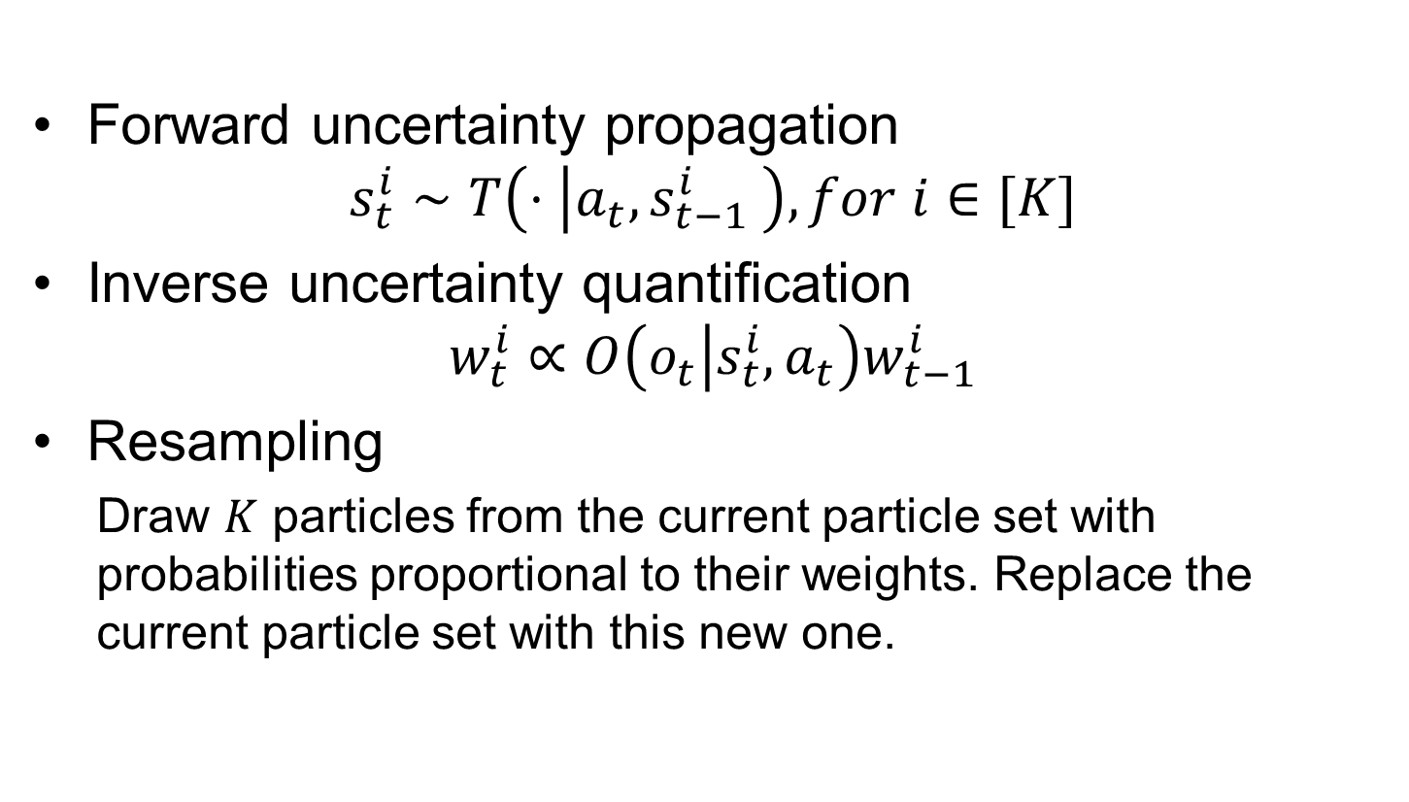
Sequential Importance Resampling (SIR) Particle Filter
Forward uncertainty propagation
$$s_{t}^{i}∼T\left(⋅ | a_{t},s_{t−1}^{i} \right), for i∈[K]$$
Inverse uncertainty quantification
$$w_{t}^{i}∝O\left(o_{t} | s_{t}^{i},a_{t}\right)w_{t−1}^{i}$$
Resampling
  Draw $K$ particles from the current particle set with probabilities proportional to their weights. Replace the current particle set with this new one.

Slide 18
POMDP with Deep Learning

Slide 19
Encoding of the history information
Methods based on RNN:
DRQN, ADRQN
Methods based on particle filters:
DVRL, PFN, PF-RNN, DPFRL, DualSMC

Slide 20
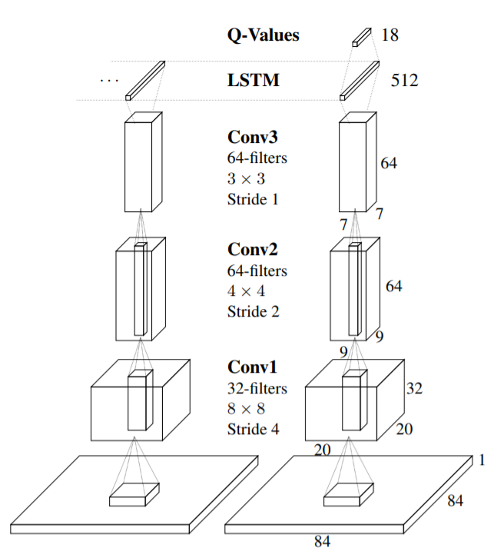
Deep Recurrent Q-Learning for Partially Observable MDPs (DRQN)
Hausknecht, M., & Stone, P. (2015). Deep Recurrent Q-Learning for Partially Observable MDPs. AAAI Fall Symposium on Sequential Decision Making for Intelligent Agents (AAAI-SDMIA15).

Slide 21
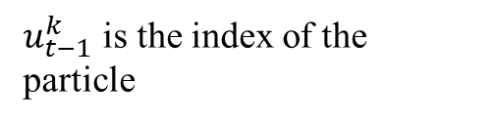
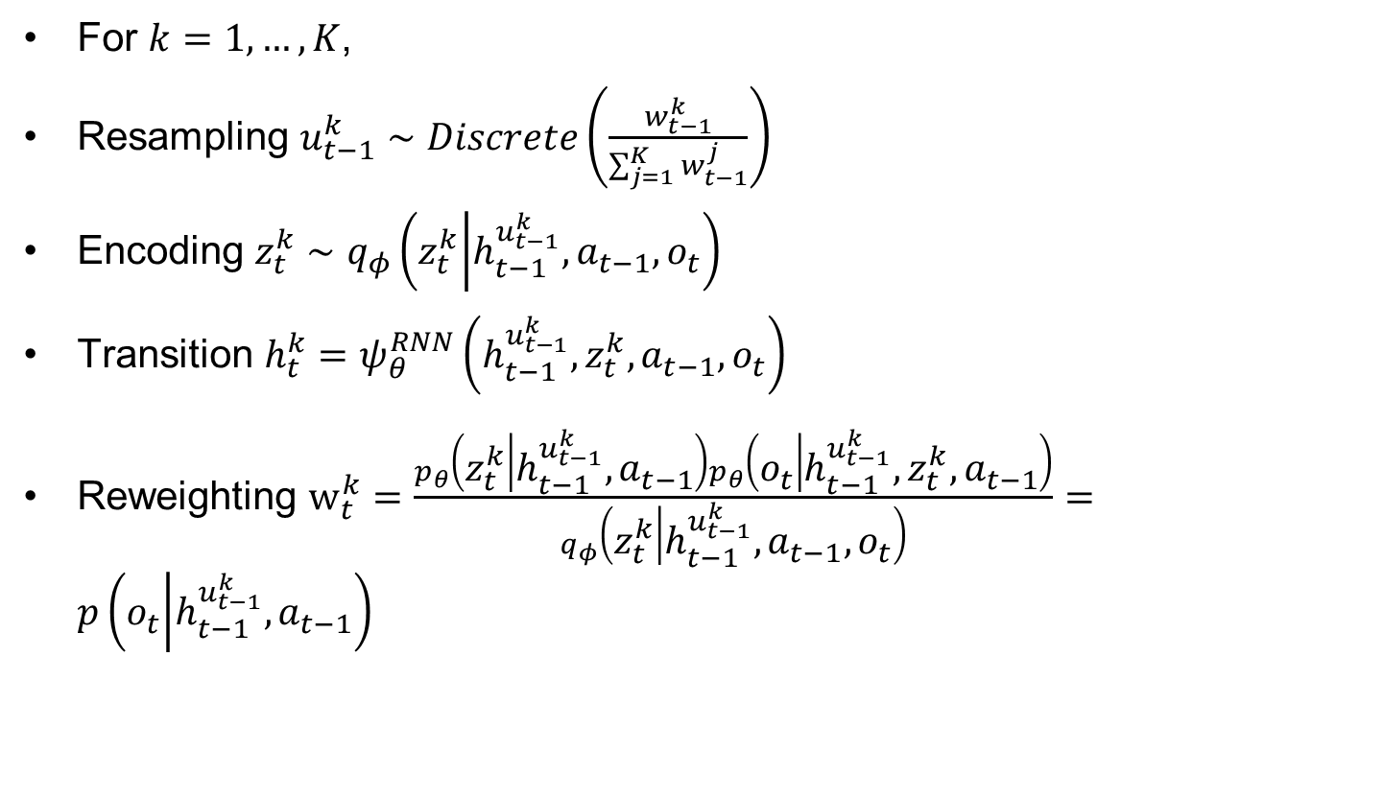
Deep Variational Reinforcement Learning
For $k=1,…,K$,
Resampling $u_{t−1}^{k}∼Discrete\left(\frac{w_{t−1}^{k}}{\sum_{j=1}^{K}{w_{t−1}^{j}}}\right)$
Encoding $z_{t}^{k}∼q_{φ}\left(z_{t}^{k} | h_{t−1}^{u_{t−1}^{k}},a_{t−1},o_{t}\right)$
Transition $h_{t}^{k}=ψ_{θ}^{RNN}\left(h_{t−1}^{u_{t−1}^{k}},z_{t}^{k},a_{t−1},o_{t}\right)$
Reweighting $w_{t}^{k}=\frac{p_{θ}\left(z_{t}^{k} | h_{t−1}^{u_{t−1}^{k}},a_{t−1}\right)p_{θ}\left(o_{t} | h_{t−1}^{u_{t−1}^{k}},z_{t}^{k},a_{t−1}\right)}{q_{φ}\left(z_{t}^{k} | h_{t−1}^{u_{t−1}^{k}},a_{t−1},o_{t}\right)}=p\left(o_{t} | h_{t−1}^{u_{t−1}^{k}},a_{t−1}\right)$
$u_{t−1}^{k}$ is the index of the particle
Introduce some randomness into transition
Igl, M., Zintgraf, L., Le, T. A., Wood, F., & Whiteson, S. (2018). Deep Variational Reinforcement Learning for POMDPs. In J. Dy & A. Krause (Eds.), International Conference on Machine Learning (Vol. 80, pp. 2117–2126). PMLR.

Slide 22
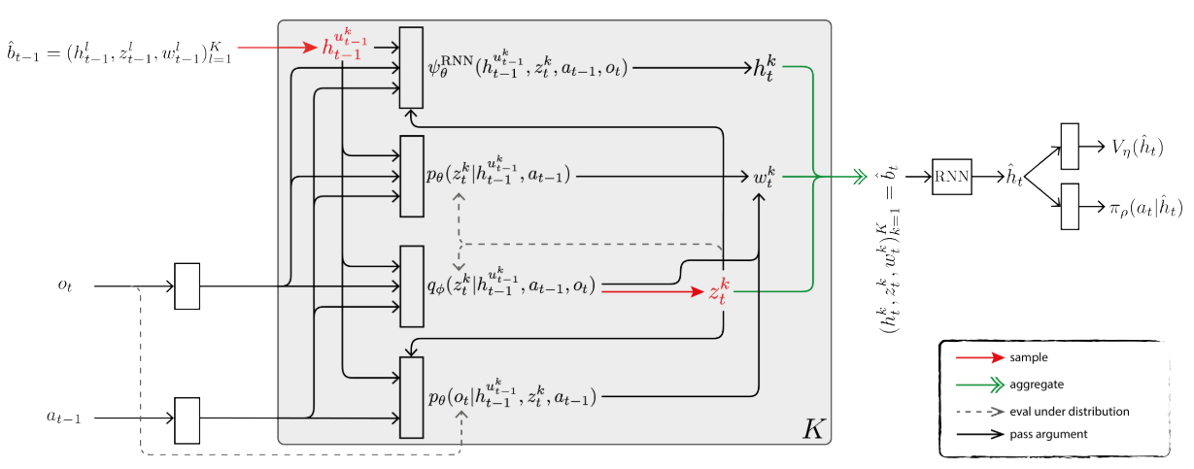
Illustration
Resampling
Transition
Latent belief
Encode particle set
Reweighting
Encoding

Slide 23
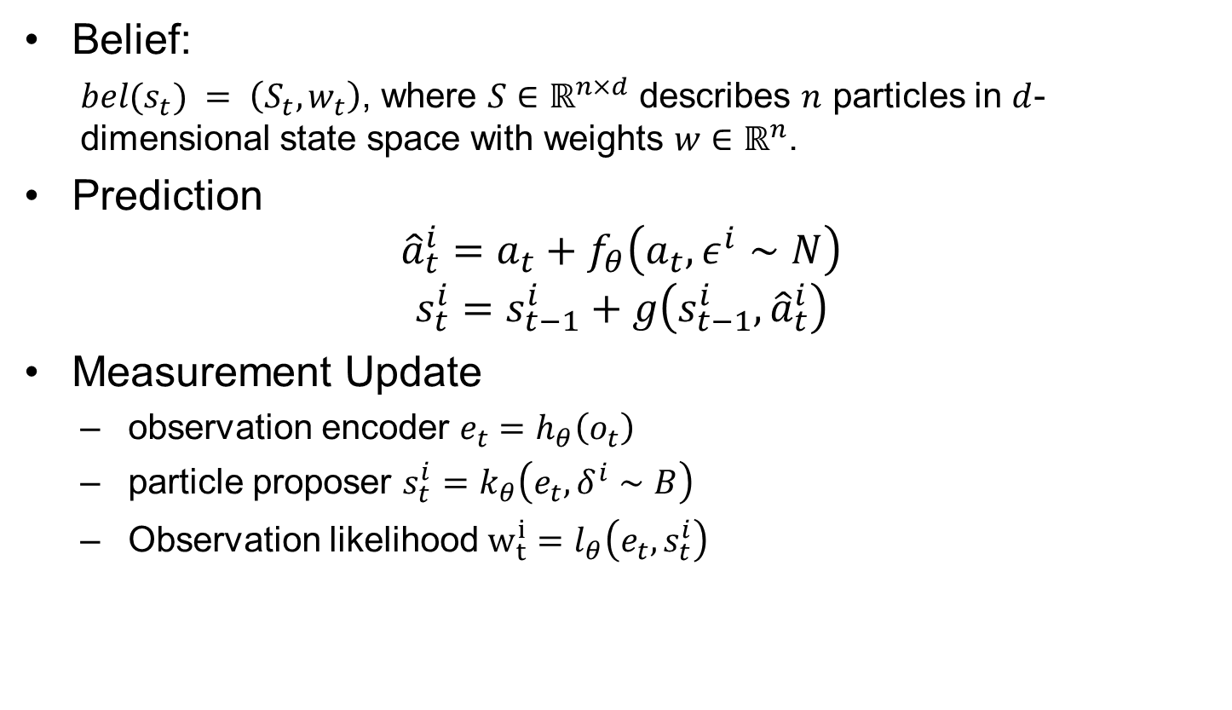
Differentiable particle filters: End-to-end learning with algorithmic priors
Belief:
  $bel(s_{t}) = \left(S_{t},w_{t}\right)$, where $S∈ℝ^{n×d}$ describes $n$ particles in $d$-dimensional state space with weights $w∈ℝ^{n}$.
Prediction
$${\hat{a}}_{t}^{i}=a_{t}+f_{θ}\left(a_{t},ε^{i}∼N\right)$$
$$s_{t}^{i}=s_{t−1}^{i}+g\left(s_{t−1}^{i},{\hat{a}}_{t}^{i}\right)$$
Measurement Update
  observation encoder $e_{t}=h_{θ}\left(o_{t}\right)$
  particle proposer $s_{t}^{i}=k_{θ}\left(e_{t},δ^{i}∼B\right)$
  Observation likelihood $w_{t}^{i}=l_{θ}\left(e_{t},s_{t}^{i}\right)$
Jonschkowski, R., Rastogi, D., & Brock, O. (2018). Differentiable particle filters: End-to-end learning with algorithmic priors. Proceedings of Robotics: Science and Systems.

Slide 24
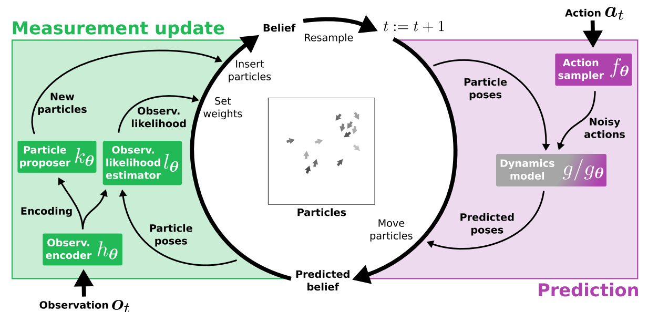
Illustration

Slide 25
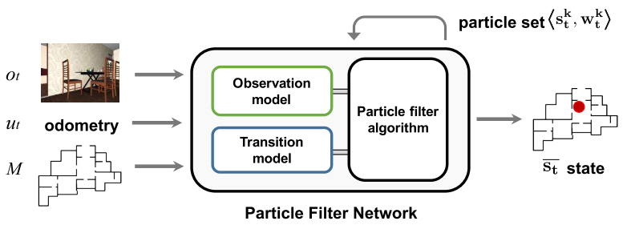
Particle Filter Networks with Application to Visual Localization
Karkus, P., Hsu, D., & Lee, W. S. (2018). Particle Filter Networks with Application to Visual Localization. In A. Billard, A. Dragan, J. Peters, & J. Morimoto (Eds.), Conference on Robot Learning (Vol. 87, pp. 169–178). PMLR.

Slide 26
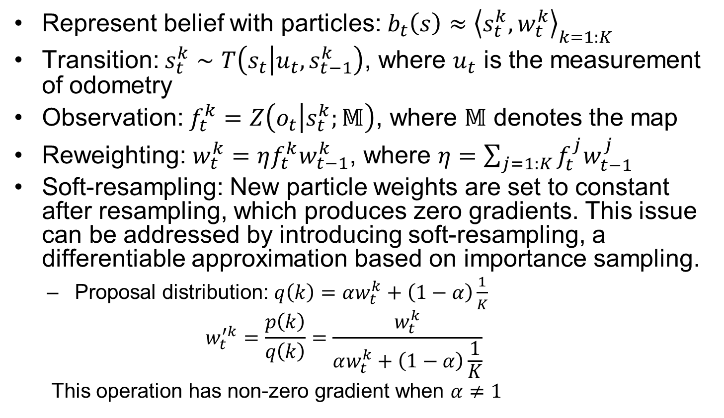
Details
Represent belief with particles: $b_{t}\left(s\right)≈{\left\langle s_{t}^{k},w_{t}^{k}\right\rangle }_{k=1:K}$
Transition: $s_{t}^{k}∼T\left(s_{t} | u_{t},s_{t−1}^{k}\right)$, where $u_{t}$ is the measurement of odometry
Observation: $f_{t}^{k}=Z\left(o_{t} | s_{t}^{k};𝕄\right)$, where $𝕄$ denotes the map
Reweighting: $w_{t}^{k}=ηf_{t}^{k}w_{t−1}^{k}$, where $η=\sum_{j=1:K}{f_{t}^{j}w_{t−1}^{j}}$
Soft-resampling: New particle weights are set to constant after resampling, which produces zero gradients. This issue can be addressed by introducing soft-resampling, a differentiable approximation based on importance sampling.
  Proposal distribution: $q\left(k\right)=αw_{t}^{k}+\left(1−α\right)\frac{1}{K}$
  $$w_{t}^{′k}=\frac{p\left(k\right)}{q\left(k\right)}=\frac{w_{t}^{k}}{αw_{t}^{k}+\left(1−α\right)\frac{1}{K}}$$
  This operation has non-zero gradient when $α≠1$

Slide 27
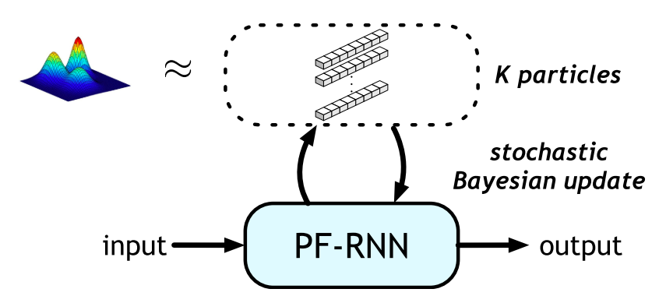
Particle Filter Recurrent Neural Networks
Ma, X., Karkus, P., Hsu, D., & Lee, W. S. (2020). Particle Filter Recurrent Neural Networks. Proceedings of the AAAI Conference on Artificial Intelligence.

Slide 28
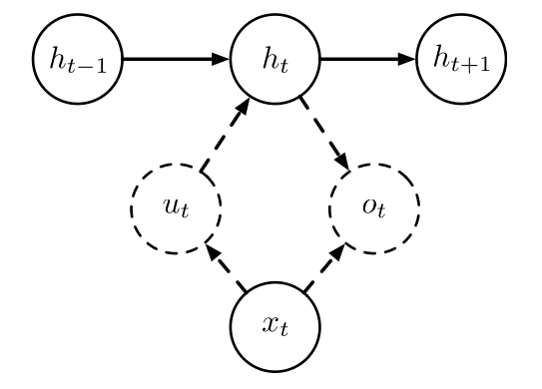
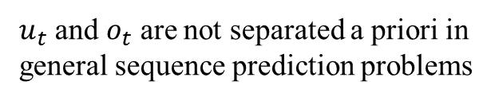
The graphical model for PF-RNN belief update
Hidden state
Action
Observation
$u_{t}$ and $o_{t}$ are not separated a priori in general sequence prediction problems

Slide 29
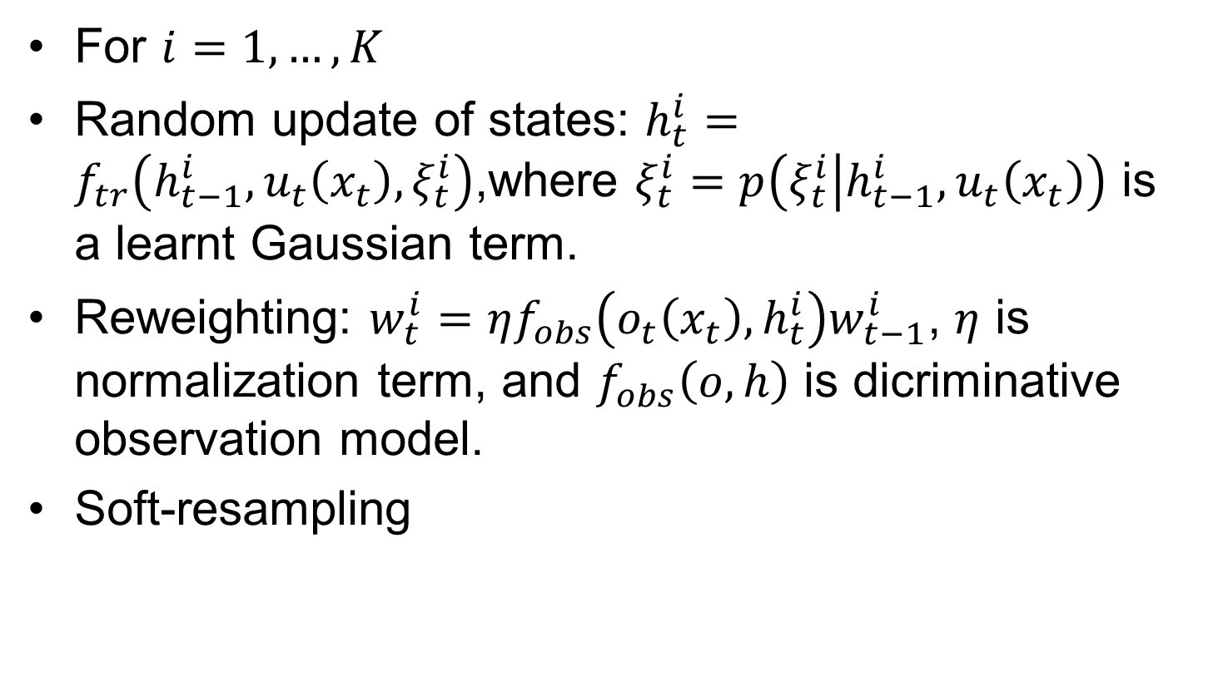
Details
For $i=1,…,K$
Random update of states: $h_{t}^{i}=f_{tr}\left(h_{t−1}^{i},u_{t}\left(x_{t}\right),ξ_{t}^{i}\right)$,where $ξ_{t}^{i}=p\left(ξ_{t}^{i} | h_{t−1}^{i},u_{t}\left(x_{t}\right)\right)$ is a learnt Gaussian term.
Reweighting: $w_{t}^{i}=ηf_{obs}\left(o_{t}\left(x_{t}\right),h_{t}^{i}\right)w_{t−1}^{i}$, $η$ is normalization term, and $f_{obs}\left(o,h\right)$ is dicriminative observation model.
Soft-resampling

Slide 30
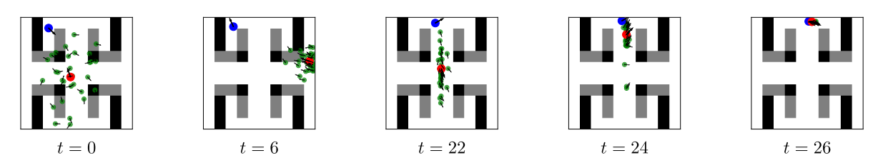
Robot Localization
Observation: oscillated distances to the five closest landmarks

Slide 31
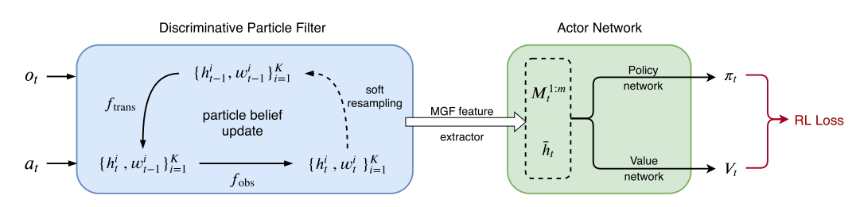


Discriminative Particle Filter Reinforcement Learning for Complex Partial Observations
$M_{t}^{1:m}$ are m MGF features
${\overline{h}}_{t}$ is a mean particle
Ma, X., Karkus, P., Hsu, D., Lee, W. S., & Ye, N. (2020). Discriminative Particle Filter Reinforcement Learning for Complex Partial Observations. International Conference on Learning Representations. https://openreview.net/forum?id=HJl8_eHYvS

Slide 32
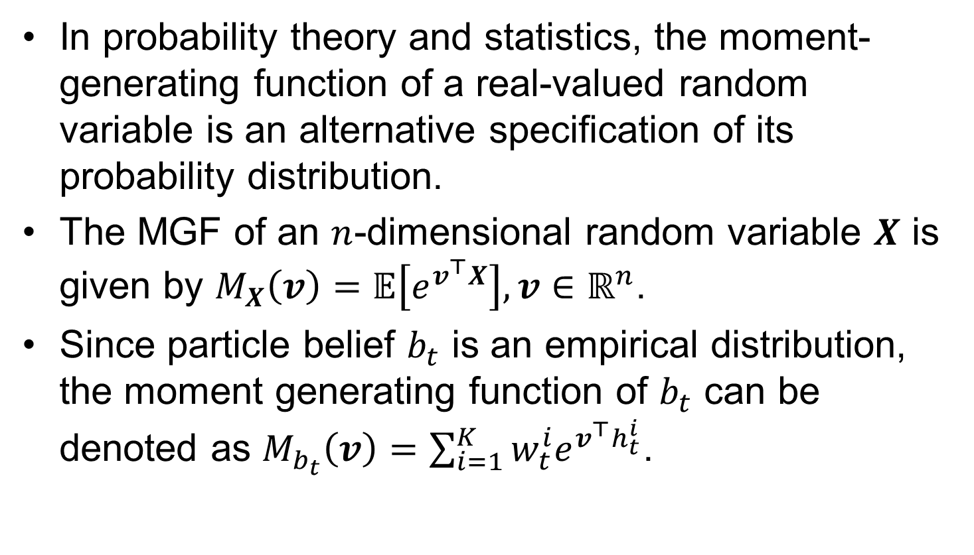
Moment Generating Function (MGF)
In probability theory and statistics, the moment-generating function of a real-valued random variable is an alternative specification of its probability distribution.
The MGF of an $n$-dimensional random variable $X$ is given by $M_{X}\left(v\right)=𝔼\left[e^{v^{⊤}X}\right],v∈ℝ^{n}$.
Since particle belief $b_{t}$ is an empirical distribution, the moment generating function of $b_{t}$ can be denoted as $M_{b_{t}}\left(v\right)=\sum_{i=1}^{K}{w_{t}^{i}e^{v^{⊤}h_{t}^{i}}}$.

Slide 33
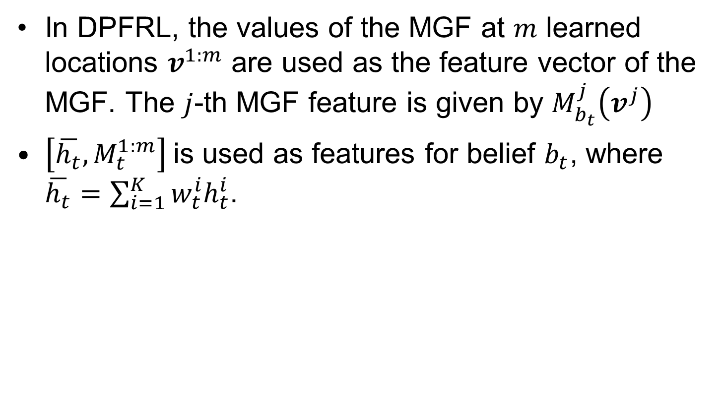
Features
In DPFRL, the values of the MGF at $m$ learned locations $v^{1:m}$ are used as the feature vector of the MGF. The $j$-th MGF feature is given by $M_{b_{t}}^{j}\left(v^{j}\right)$
$\left[\overline{h_{t}},M_{t}^{1:m}\right]$is used as features for belief $b_{t}$, where $\overline{h_{t}}=\sum_{i=1}^{K}{w_{t}^{i}h_{t}^{i}}$.

Slide 34
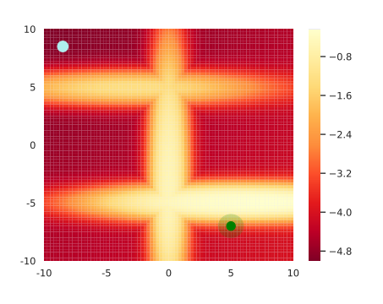
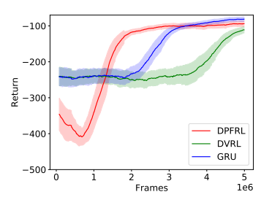
Mountain Hike

Slide 35
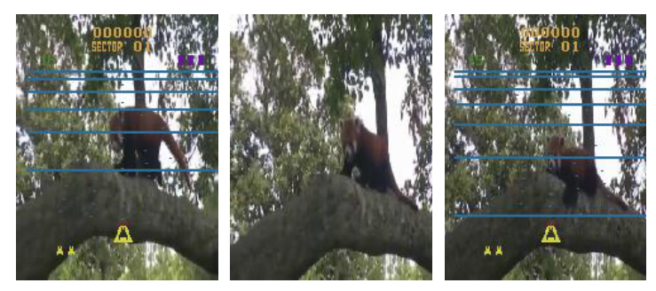
Natural Flickering Atari

Slide 36
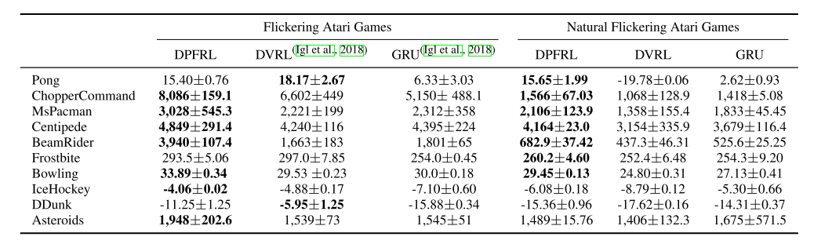
Results on Flickering Atari

Slide 37
Summary
A brief introduction to POMDP
Encoding of the history information

Slide 38
Thanks!

